Slide 1

Integrating Backup Into Your GitOps CI/CD Pipeline
Michael Cade
Senior Technologist
Kasten by Veeam
@MichaelCade1

Slide 2
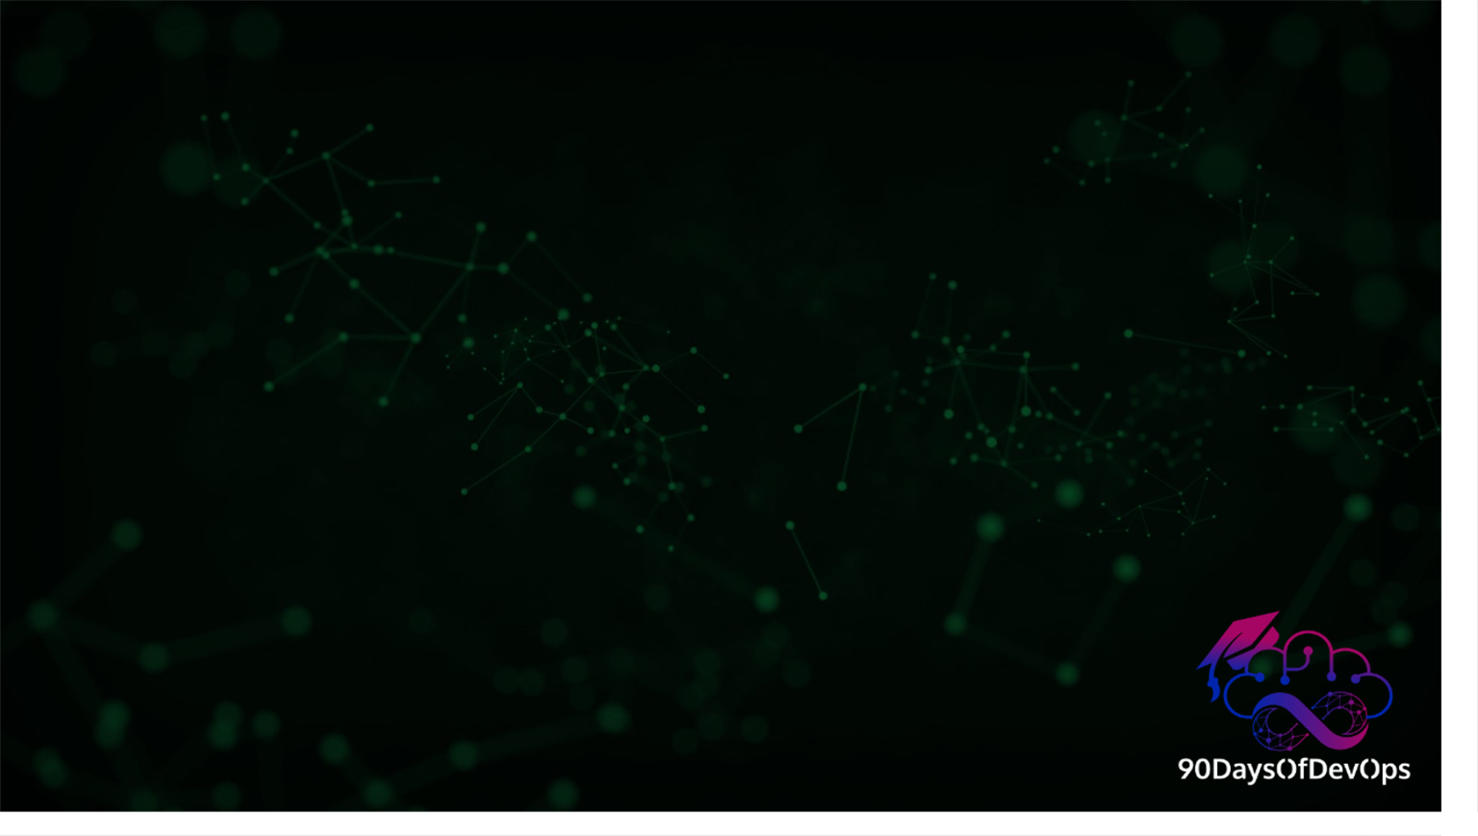
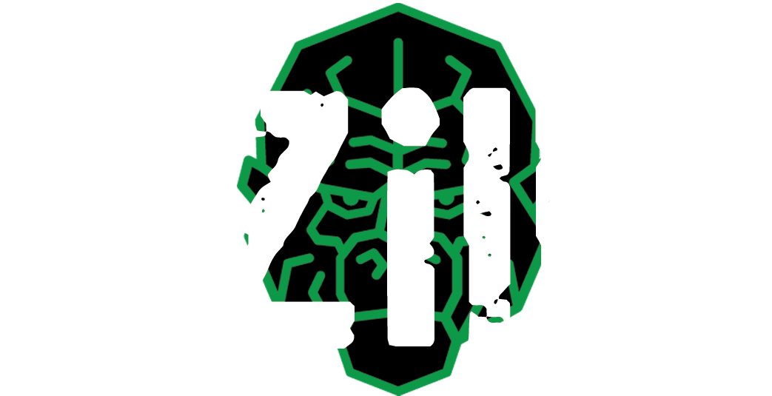






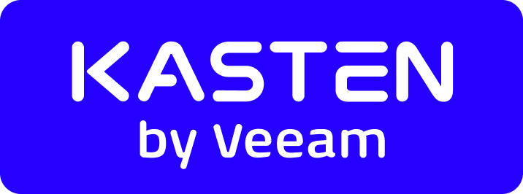
Who Am I?
Michael Cade
Senior Technologist, Product Strategy
Michael.Cade@veeam.com
@MichaelCade1

Slide 3

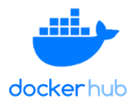

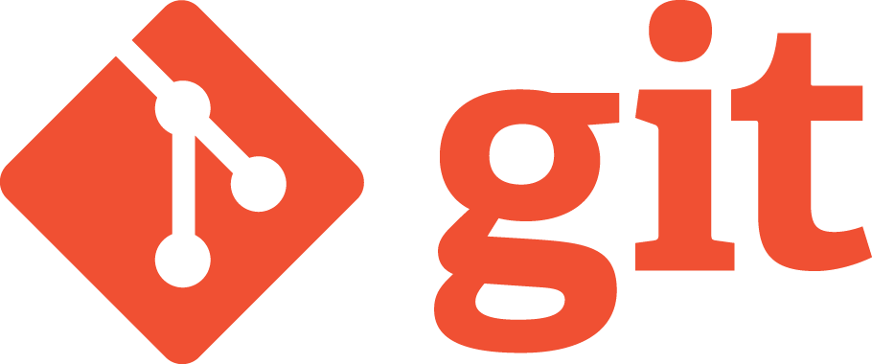


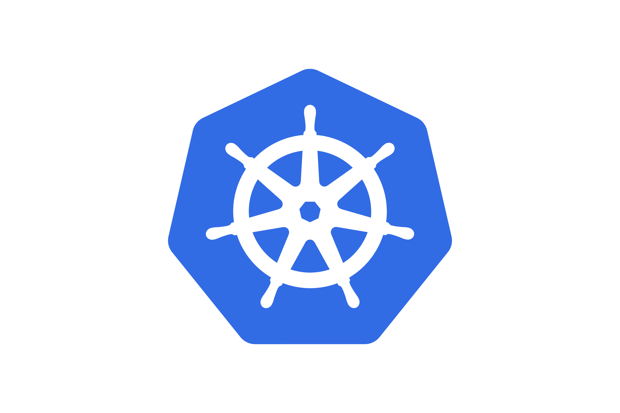

CI / CD Continuous Integration / Deployment / Delivery
Continuous Integration
Code
Build
Test
Release
Staging
Update
Deploy
Production
Continuous Deployment

Slide 4


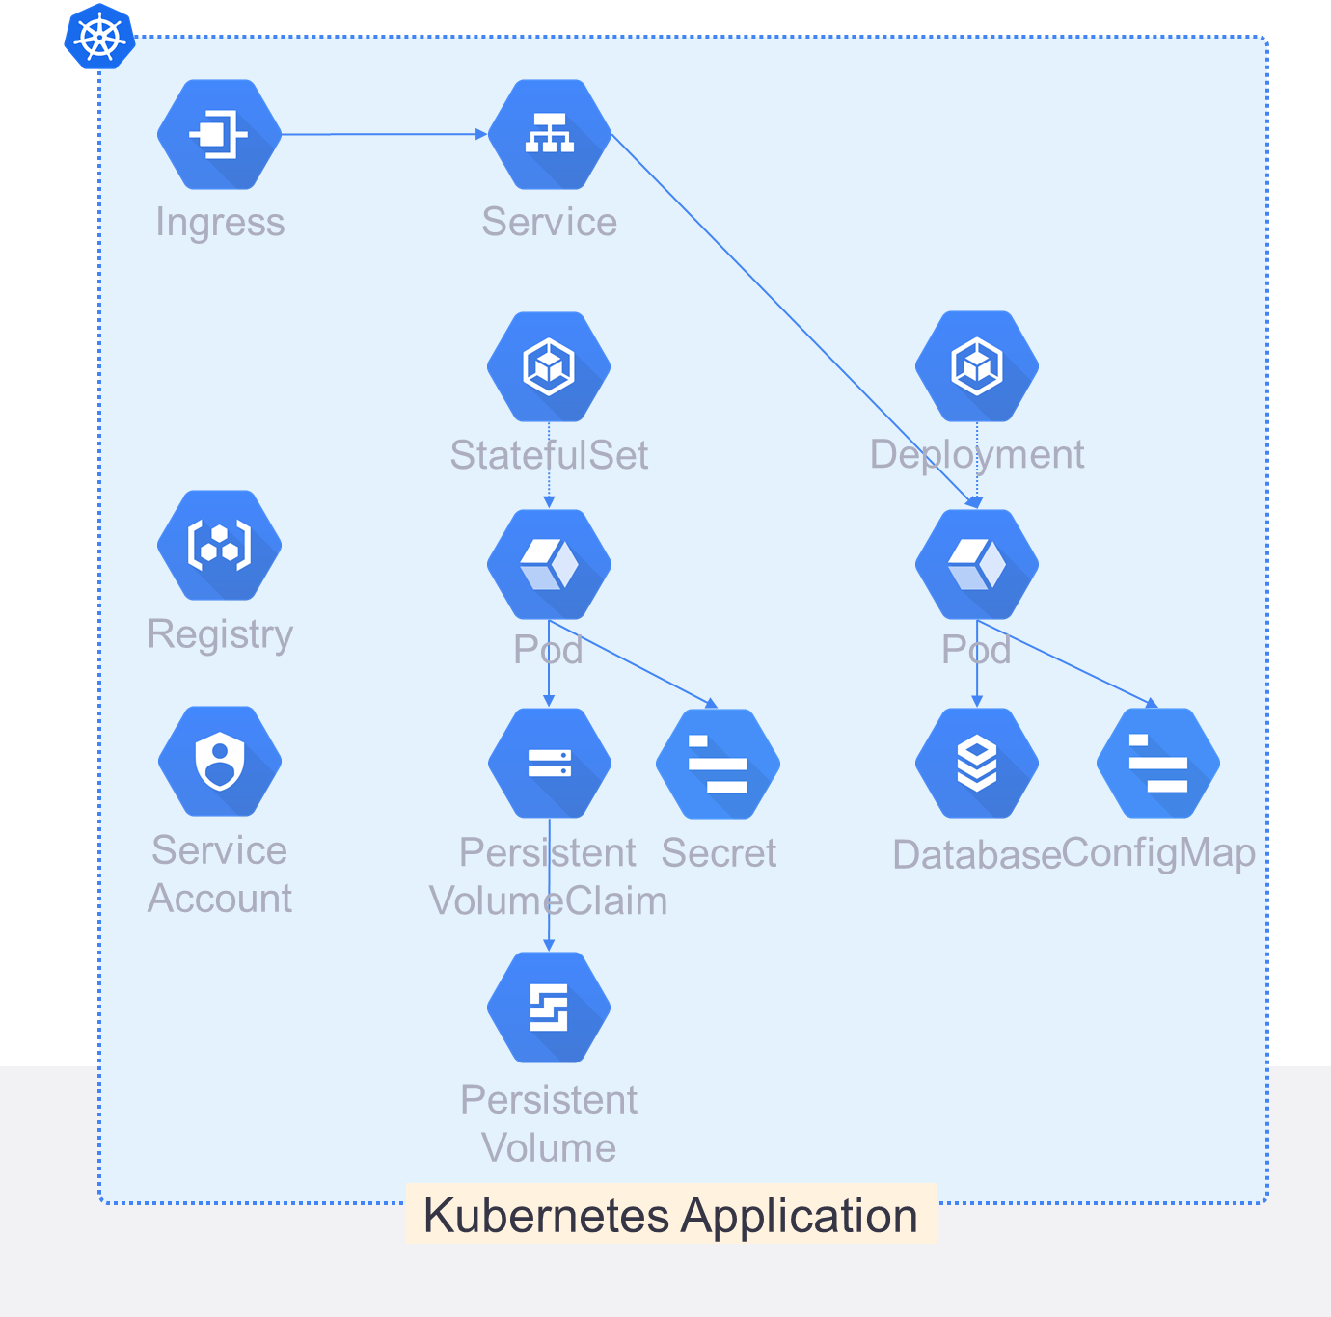


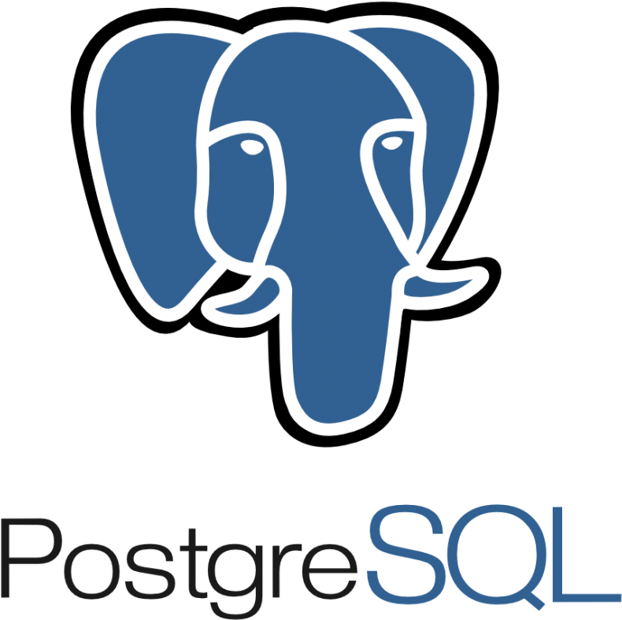
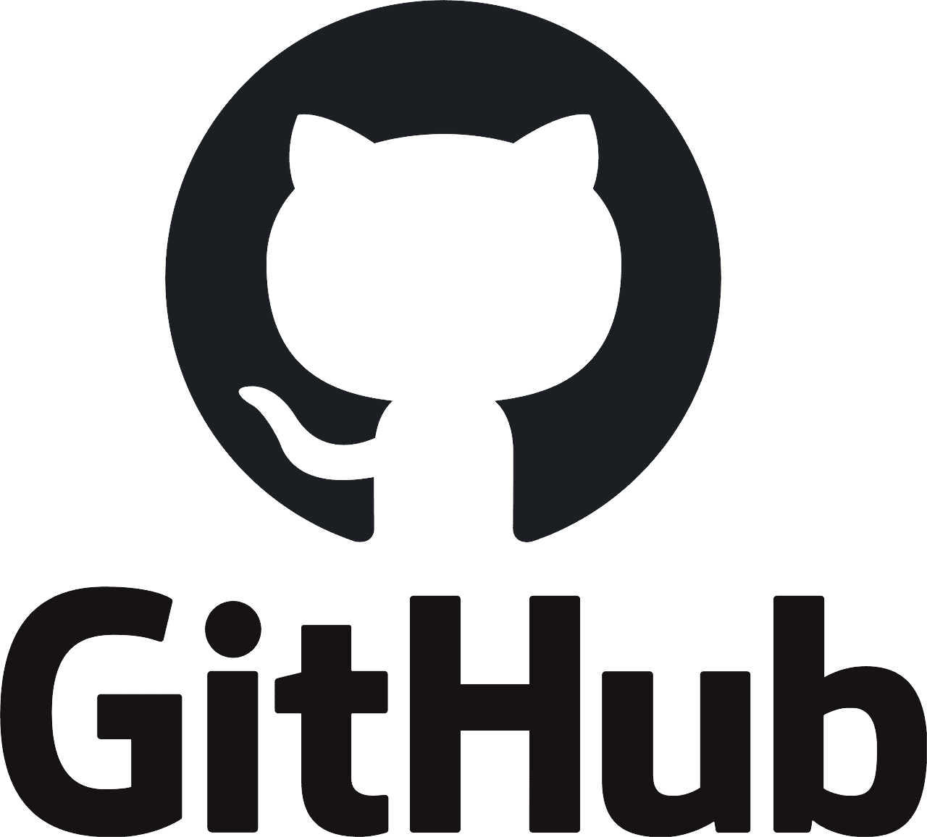

The Need for Backup Automated safety with scale
Persistent Volume
Notes:
I think we can all agree that moving to a model where your application and resource configuration is defined as code is beneficial to everyone involved. This code is usually saved in git, the most popular source version control system for cloud-native projects, and provides an automatic and verifiable change capture process, and simplifies application rollout.

Slide 5

Data It’s All About the Data!
Brings back Kubernetes Objects & Configuration
Persistent data is not captured in version control!
Notes:
The biggest thing to note is that any automated way of deploying an application will only bring back Kubernetes objects and configuration. Any persistent data or volumes used by applications are not captured in version control, and therefore to bring back any stateful service, such as a relational database or NoSQL system, requires that the entire application stack, its data, and the dependencies of the stack on the data be discovered, tracked, and captured.

Slide 6

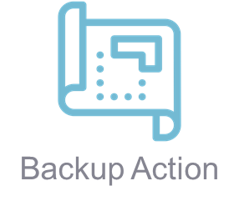
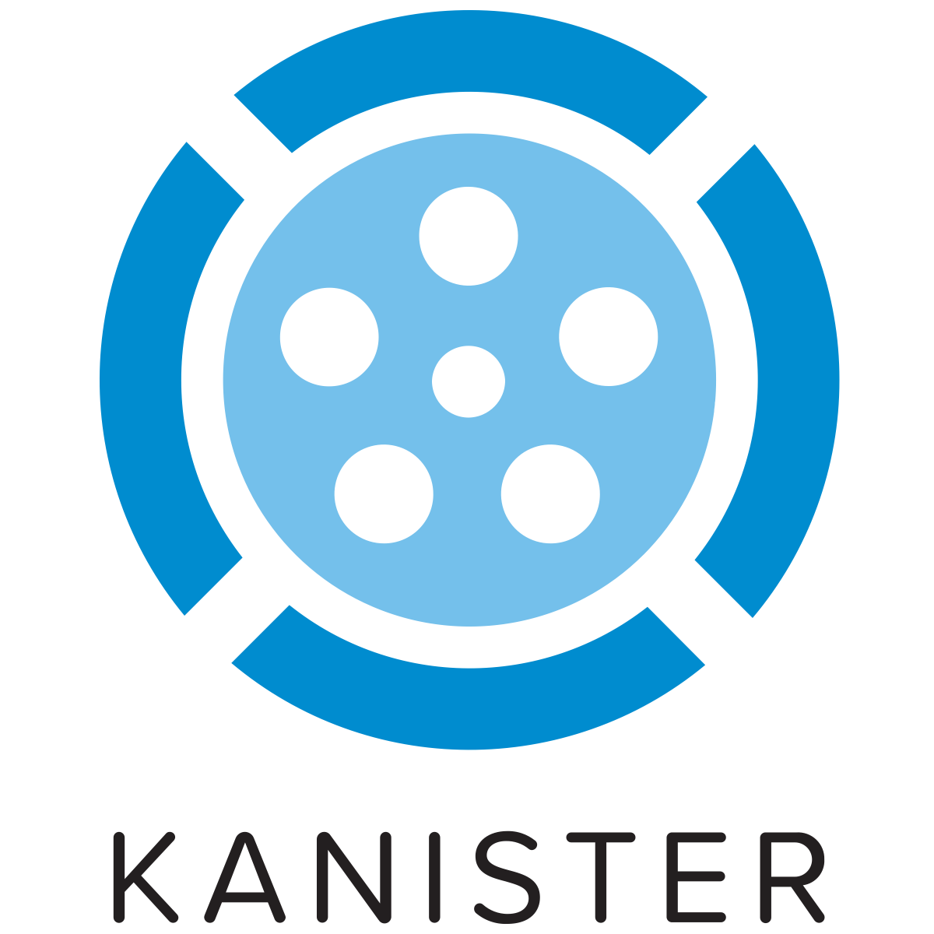


Data It’s All About the Data!
Any persistent data or volumes used by applications are not captured in version control
Example: any stateful service, such as a relational database or NoSQL system
Requires the entire application stack including the data!
Data, and the dependencies of the stack on the data be discovered, tracked, and captured.
Persistent Volume
Notes:
The biggest thing to note is that any automated way of deploying an application will only bring back Kubernetes objects and configuration. Any persistent data or volumes used by applications are not captured in version control, and therefore to bring back any stateful service, such as a relational database or NoSQL system, requires that the entire application stack, its data, and the dependencies of the stack on the data be discovered, tracked, and captured.

Slide 7
Additional after this morning sessions!
Victor says no databases in Kubernetes.... bang goes my demo!
This walkthrough would also work with AWS RDS using a Kanister Blueprint*
I am using ArgoCD because Victor used Flux and I like to be fair but anything with the ability to run pre sync and waves (naming might be different)
The goal of the demo:
As we release a new change to our application, I want to make sure we have a good copy of our data before the change is deployed!

Slide 8
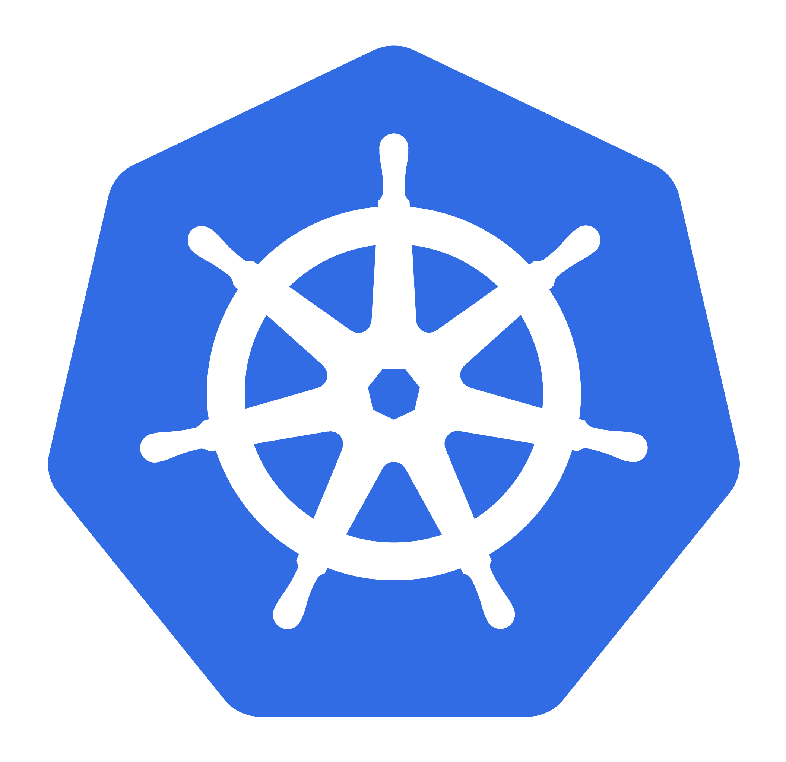

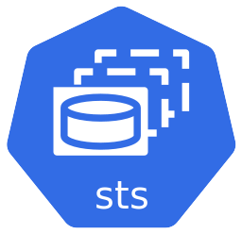



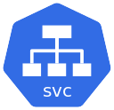
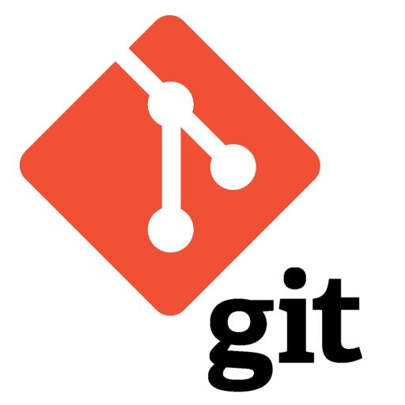
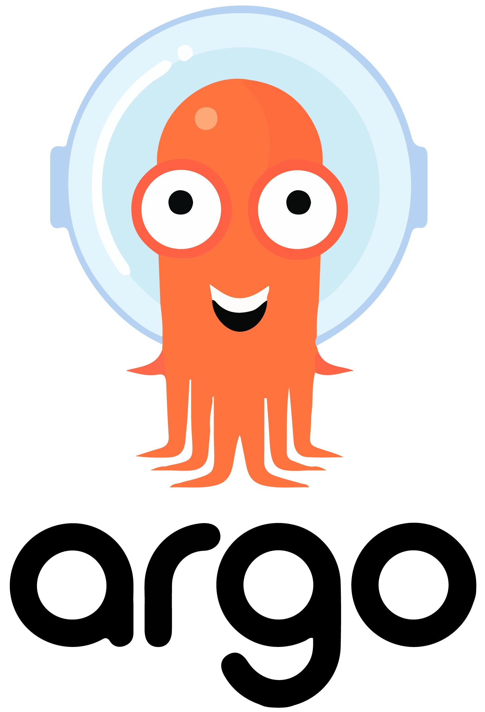

kasten-io
stock-demo
Remote Storage
argocd
User

Slide 9

kasten-io
mysql
Remote Storage
argocd
User

Slide 10

kasten-io
stock-demo
Remote Storage
argocd
User

Slide 11
kasten-io
stock-demo
Export
Snapshot
Remote Storage
argocd
Pre-sync
Sync
User
git commit

Slide 12
kasten-io
stock-demo
Remote Storage
argocd
Sync
User
git commit

Slide 13
kasten-io
stock-demo
Restore
Remote Storage
argocd
User

Slide 14


Slide 15

If you want to follow along

Slide 16
